Slide 1
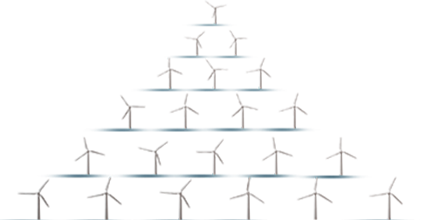

Slide 2
PGE as promoter of the development of the offshore industry in Poland
1

Slide 3
PGE as promoter of the development of the offshore industry
in Poland
PGE – leader of the energy transition process in Poland.
Creating a local supply chain will provide a stimulus to the national economy.
Transparent information on the process and openness to feedback.
Partnership with Ørsted.

Slide 4
Offshore wind farms – impact on the development of key industries
Direct beneficiaries of the OWF investments:
Shipyard industry.
Steel industry.
Port industry.
Technological and construction services as indirect beneficiaries:
Devices and materials.
Production of components of the wind turbines.
Other additional services necessary for the construction and exploitation, including:
Project works.
Substantive works and expertise's.
Certification and training.

Slide 5
Potential of the offshore wind energy in Europe and Poland
2

Slide 6
Offshore wind industry in Europe
Offshore wind in Europe.
>23 GW installed capacity
Investments in 2020 – €26 billion.
British experience in establishing the offshore wind supply chain.
Potential of the Baltic Sea.
Even 28 GW installed capacity.
Projects implemented by PGE up to 2030 – investments in the order of PLN 40-50 billion.

Slide 7
Stable framework for development
3

Slide 8
Stable framework for the development of the OWF industry
EU strategy for the offshore sector - 300 GW of power in offshore wind farms by 2050.
Energy Policy of Poland until 2040:
offshore wind farms as a key technology and strategic project of the Polish energy policy
Installed OWF capacity 5.9 GW by 2030, up to 11 GW in 2040
Act on promoting the generation of electricity in the offshore wind farms.
European Commission approved the Polish support programme until 2030 with a budget of EUR 22.5 billion.

Slide 9
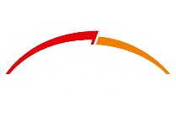
Thank you for your attention
Warsaw, 18 June 2021

